Slide 1


IOT based smart check weigher data system

Slide 2


Team members
Rajesh Teredesai
ND-19-349
Omkar Bhave
N-18-0303
Parth R Sawant
N-18-0273
B.E. ETRX 2021-22
Guide
CO-Guide
Prof. V. V. Nimbalkar
Prof. S. R. Nalage

Slide 3
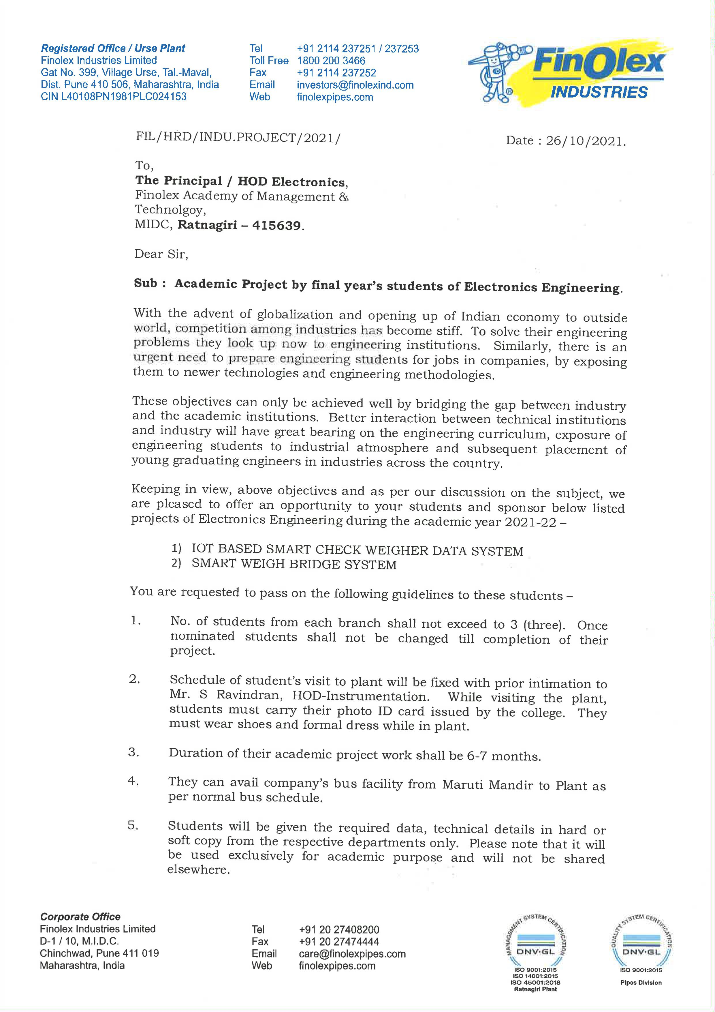
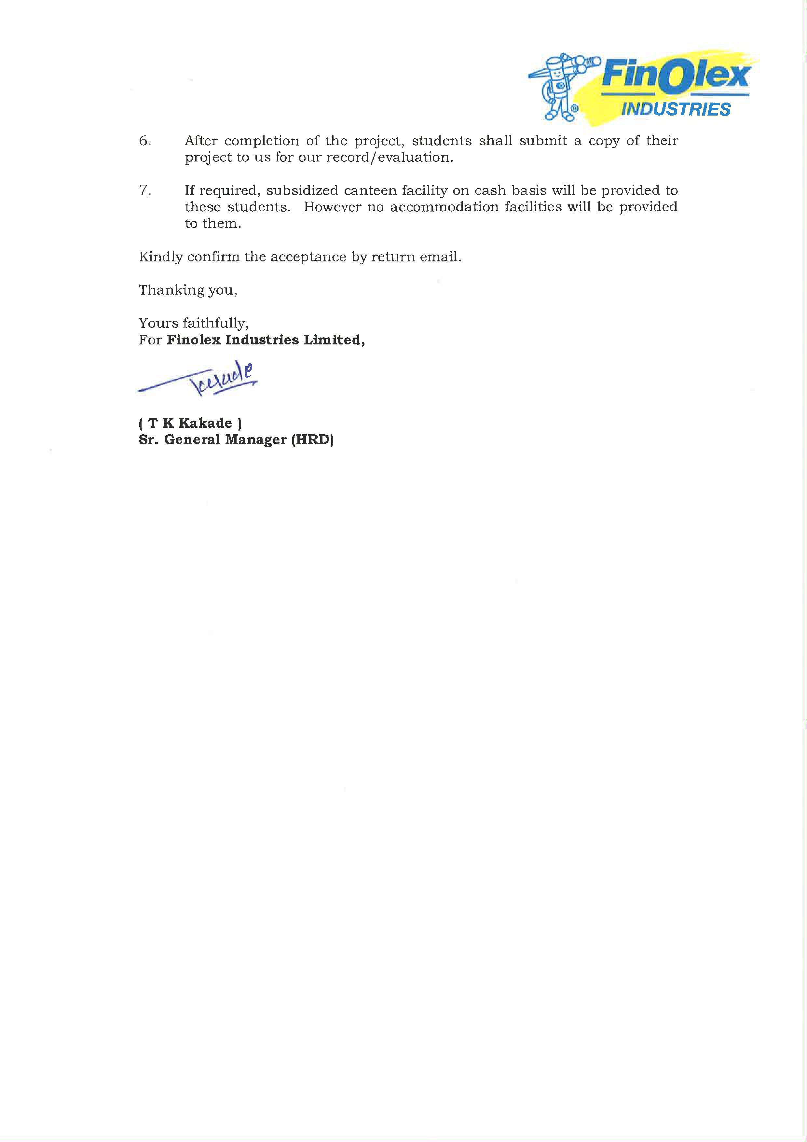
Sponsor by
Finolex Industries, Ratnagiri

Slide 4

idea
Currently, a company loads two sample bags and weighs them as a palate out of 60 bags per bag weighing 25kg. Thus, the dispatch palate is not of accurate weight, which is why we are developing and implementing an Io T-based solution to this problem.

Slide 5
Every bag will be measured using a load cell, and its net weight will be serially transmitted via RS232, and its net weight is then extracted from the frame format.
A comparison follows between the extracted weight and the ideal weight. The bag is forwarded for packing if the weight matches; simultaneously, the weight is displayed and recorded in an excel spreadsheet.
The bag will not be processed if its weight is wrong. Stacks of sixty accurately weighed bags are packed by repeating this process. Such a stack is referred to as a palette.
Initially, we will be implementing the idea using Python, and at a later stage, we will use ESP8266 hardware.
Further modifications can be made by using industrial micro-controllers (i.e., PIC16F).

Slide 6


introduction
As people are getting smarter, so are the things. The Internet of Things (IoT) is a system of connecting mechanical and digital machines, animals or people with interrelated computing devices to provide an ability to collect, process and transfer data over a network without requiring human interaction. While one thinks of smart cities, we should also think of advanced industries.

Slide 7
A check weigher is an automatic or manual machine for checking the weight of packaged commodities. Usually found at the end of a production process, it ensures that the weight of a pack of the commodity is within specified limits. Any packs that are outside the tolerance are taken out of line automatically.
In check weigher, the data is archived and is available for inspection. Modern check weighers typically feature communications ports (e.g., RS232 & RS485) that allow you to upload data, such as palate weight, to a host computer.
Example: A check weigher is programmed to indicate three zones with a resolution to 5g :
Under Reject - The product weighs 25.155 kg or less
Valid - The product weighs 25.160 kg
Over Reject - The product weighs over the 25.165 kg limit

Slide 8



POWER SUPPLY
Android App
ESP8266
LOAD CELL
With
Signal Conditioning
(NOVA)
EXCEL SHEET

Slide 9
FRAME FORMAT
STX | <status> | <net weight> | <grossweight> | <peak> | ETX | <chksum> | EOT
Where
STX (start of text) = 0x02h
ETX (end of text) = 0x03h
EOT (end of transmission) = 0x04.
<status> = an ASCII character that can take the following values:
“S” = stable weight
“M”= weight that is not stable (moving)
“O” = weight greater than the maximum capacity
“E” = weight that cannot be detected.
<net weight> = field consisting of 6 ASCII characters of net weight.
<gross weight> = field consisting of 6 ASCII characters of gross weight.
<peak> = field consisting of 6 ASCII characters of peak.
<chksum> = 2 ASCII control characters calculated considering the characters between STX and ETX excluded. The control value is obtained by executing the operation of XOR (or exclusive) of the 8-bit ASCII codes of the characters considered. The result is a character that is expressed in hexadecimal with 2 digits that can take values from “0” to “9” and “A” to “F”. <chksum> is the ASCII encoding of the two hexadecimal digits.

Slide 10
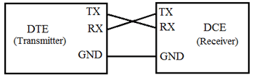
What is rs232?
RS232 is a standard protocol used for serial communication, it is used for connecting computer and its peripheral devices to allow serial data exchange between them. As it obtains the voltage for the path used for the data exchange between the devices. It is used in serial communication up to 50 feet with the rate of 1.492kbps.
Officially, RS-232 is defined as the "Interface between data terminal equipment and data communications equipment using serial binary data exchange." This definition defines data terminal equipment (DTE) as the computer, while data communications equipment (DCE) is the modem.
RS232 Protocol

Slide 11
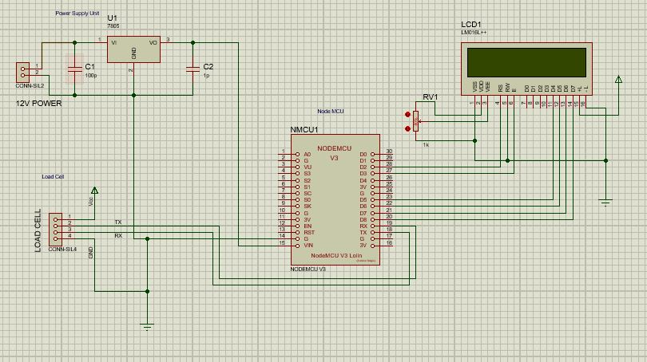
CIRCUIT DIAGRAM

Slide 12
LIVE SIMULATION

Slide 13
WORK TO BE DONE
Using hardware esp8266.
Implementing using Industrial Microcontroller PIC16f
Weight displayed on the LCD will be updated in the excel sheet during runtime.
If we are up to this point further addition of check ware that the bag outside the Torrence will be rejected from the main conveyor to rejected conveyor by Pnemupic cylinder.

Slide 14
References
https://en.wikipedia.org/wiki/Load_cell
https://instrumentationtools.com/load-cell-working-principle/
https://www.sensorsone.com/4-20ma-use-advantages-disadvantages/

Slide 15
Thank you.

